Slide 1

Working with Web Tables

Slide 2
Introduction
A table is an arrangement of data like text, numbers, links or images in rows and columns.
Accessing table data by using the "By.xpath()" method.
Reading a Table
XPath Syntax
Accessing Nested Tables
Using Attributes as Predicates
Shortcut: Use Firebug for Accessing Tables in Selenium

Slide 3
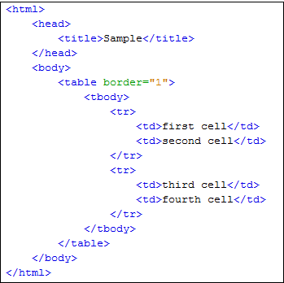
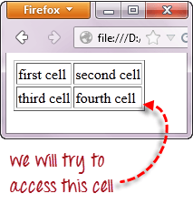
XPath Syntax
Consider the HTML code here:-
Accessing inner text of the cell containing
the text "fourth cell.

Slide 4

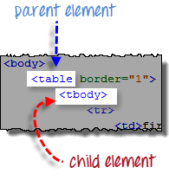
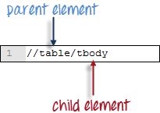
Set the Parent Element (table):-
XPath locators in Web Driver always start with a double forward slash "//" and then followed by the parent element.
In the tables the parent element should always be the <table> tag.
Add the child elements:-
Child elements in XPath are placed to the right of their parent element, separated with one forward slash "/" .
In the tables the child element immediately under parent element <table> tag is <tbody> tag.

Slide 5
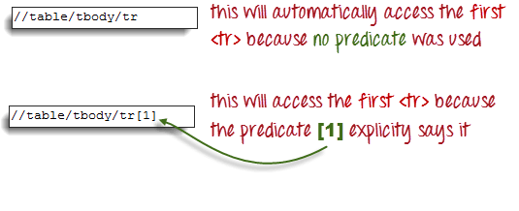
Add Predicates
The <tbody> element contains two <tr> tags. These two <tr> tags are siblings.
Siblings refer to child elements having the same parent.
Predicates used for distinguish these two <tr> tags.
Predicates are numbers or HTML attributes enclosed in a pair of square brackets "[ ]" that distinguish a child element from its siblings.

Slide 6
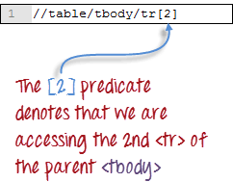

Accessing second <tr> tag in table.
Add the Succeeding Child Elements Using the Appropriate Predicates
Accessing second <td> tag in table.

Slide 7
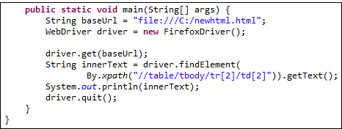
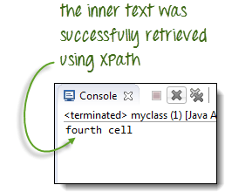
Now See the code :-
Result as:-

Slide 8
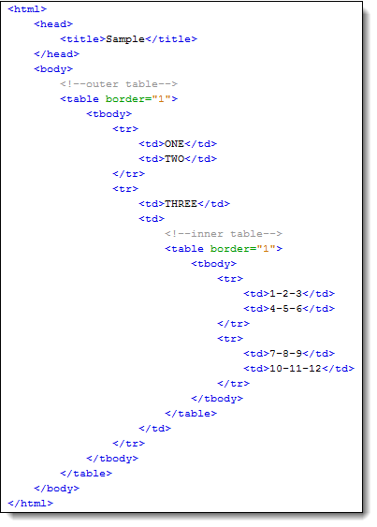
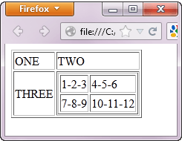
Accessing Nested Tables
Nested tables are tables located within another table.
We will try to access this cell

Slide 9
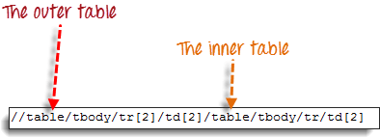
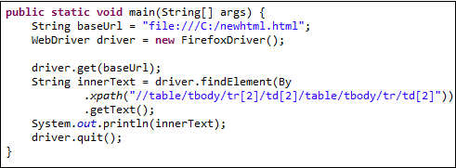
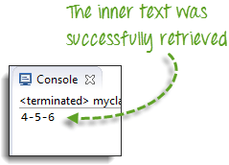
Xpath of Accessing Nested table:-
Now See the code :-
Result as:-

Slide 10
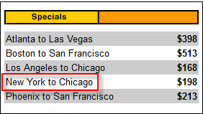
Using Attributes as Predicates
If the element is written deep within the HTML code than use the table's unique attribute (Such as width="270") as the predicate.
Attributes are used as predicates by prefixing them with the @ symbol.
In the example below, the "New York to Chicago" cell is located into Webpage.
Now See the "New York to Chicago" cell is located deep into Webpage HTML Code in next slide :-

Slide 11
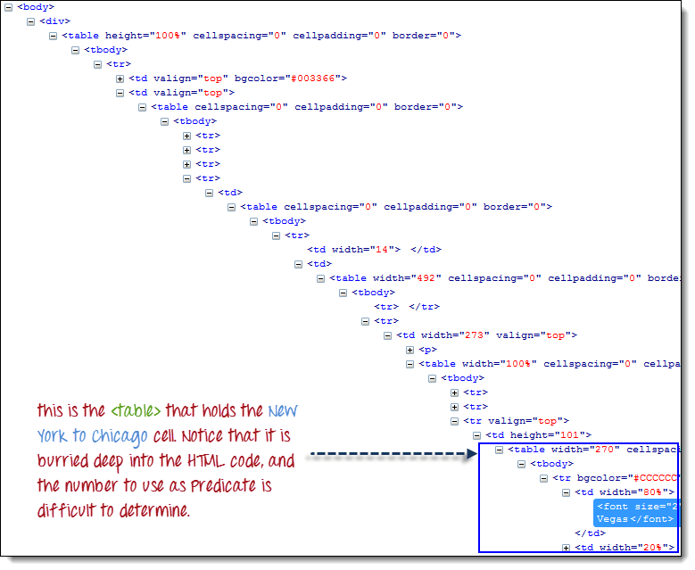

Slide 12

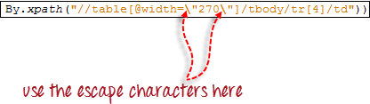
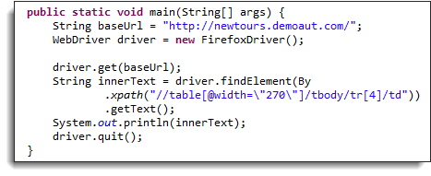
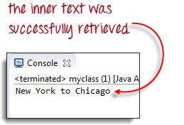
Xpath of Accessing "New York to Chicago" cell :-
Using XPath code in Java, the escape character backward slash “\" for the double quotation marks on both sides of "270" so that the string argument of By.xpath() will not be terminated prematurely.
Now see the code:-
Result:-

Slide 13
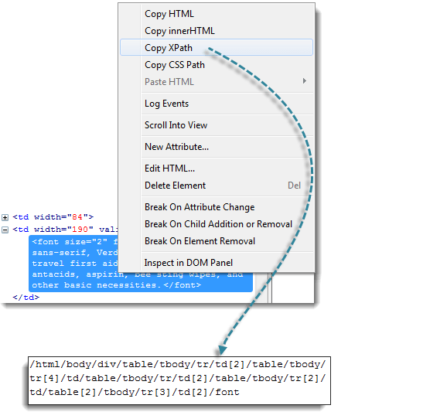
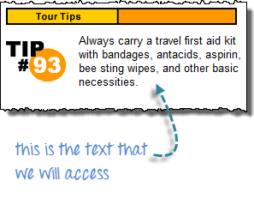
Shortcut: Use Firebug for Accessing Tables in Selenium
If the number or attribute of an element is extremely difficult to access, than XPath generate through Firebug. Such as
Use Firebug to obtain the XPath code.

Slide 14
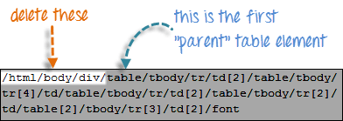
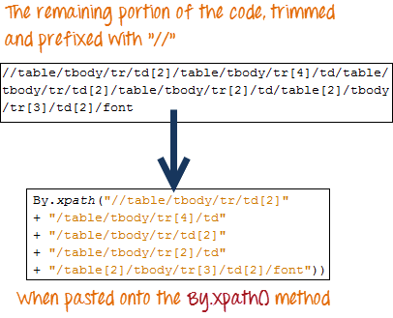
Look for the first "table" parent element and delete everything to the left of it.
Prefix the remaining portion of the code with double forward slash "//" and copy it over to your Web Driver code.

Slide 15
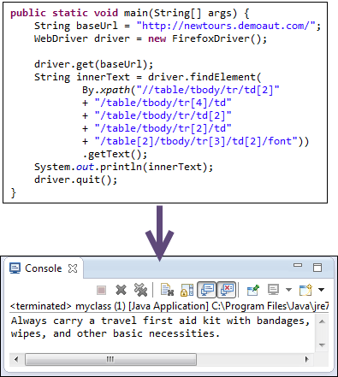
Now See the code with result :-

Slide 16
Covered Till Now
By.xpath() is commonly used to access table elements.
Accessing Nested Tables
Using Attributes as Predicates
Use Firebug for Accessing Tables in Selenium

Slide 17
Thanks

